Slide 1
SKKU Lab Recommendation Service : FindMyLab
Team J (Last Lap) 김현진 송민석 장민석 조재희
2024-Fall Capstone Design Project
Notes:
Hello, everyone. My name is Minseok from Team J, and I would like to introduce our Sungkyunkwan university laboratory recommendation service, ‘FindMyLab.’

Slide 2
Contents
1
2
3
4
5
6
Motivation
Related Work
Problem
Statement
Proposed
Solution
Technical
Background
Role &
Planning
2024-Fall Capstone Design Project
Team J (Last Lap) 김현진 송민석 장민석 조재희
Notes:
The presentation will proceed in the following order.

Slide 3
1. Motivation
“What are some ways to build
the competitiveness of your field of interest?”
2024-Fall Capstone Design Project
Team J (Last Lap) 김현진 송민석 장민석 조재희
Notes:
Most of you here are likely seniors preparing for employment or graduate enrollment. Perhaps most students have decided on what they want to do in the future. But What are some ways to build the competitiveness of your field of interest?

Slide 4
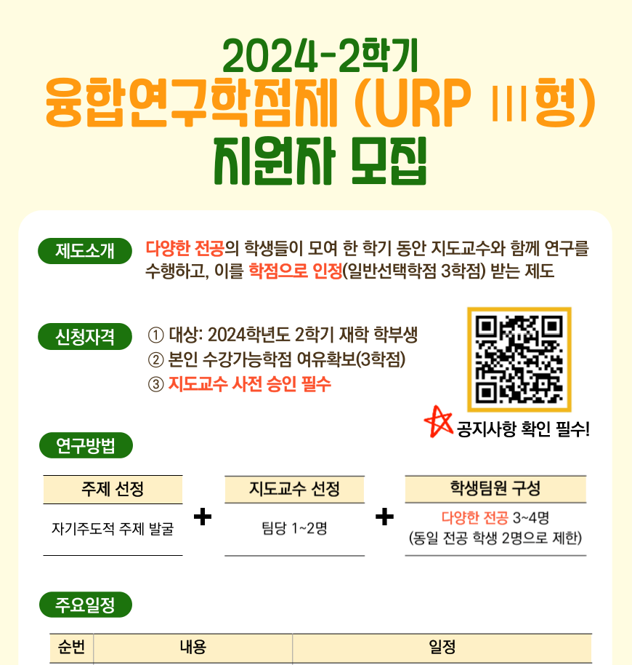
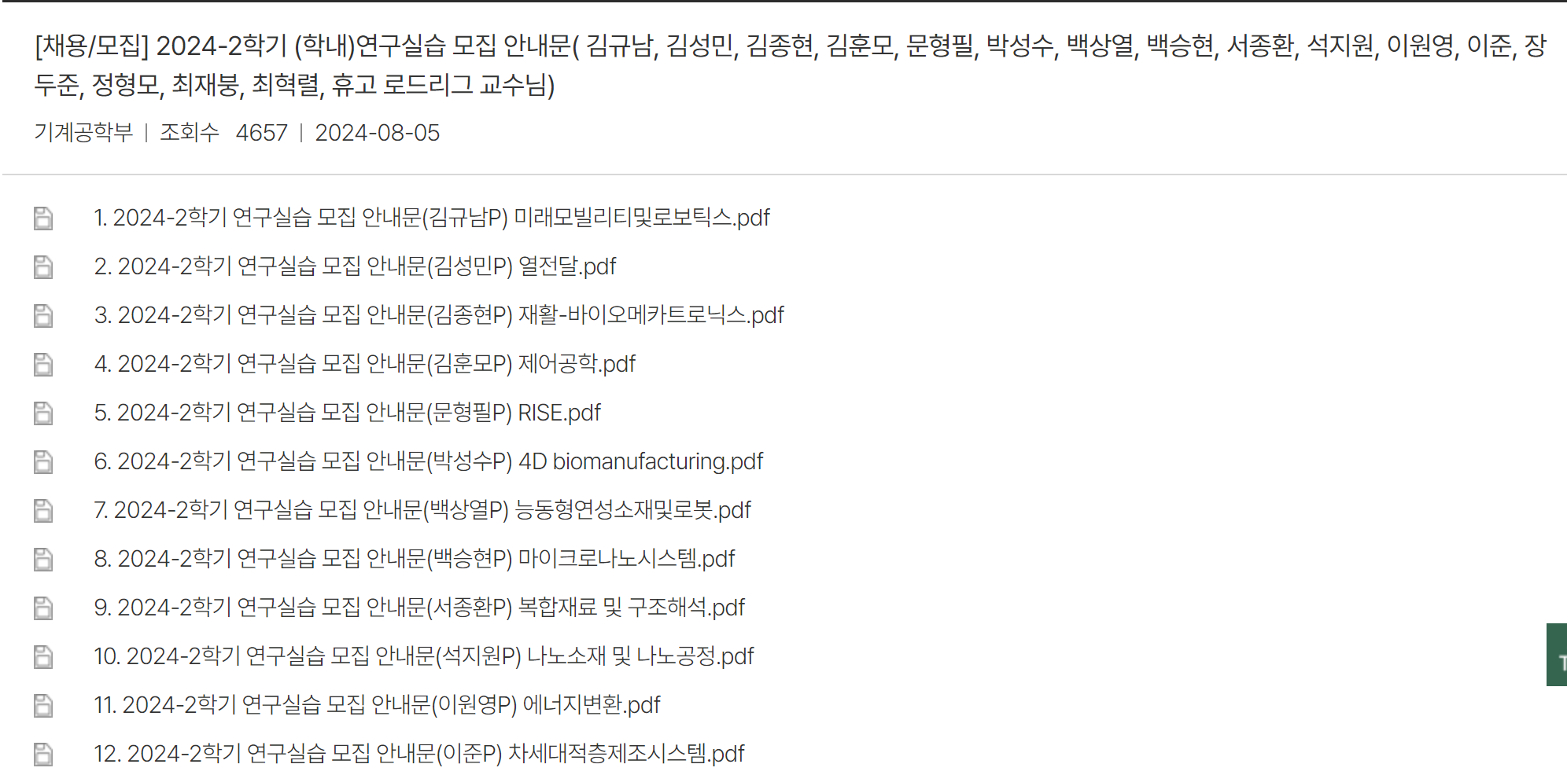

1. Motivation
1
Undergraduate Research Participation program (URP)
2
In-school Research Practice(Co-op)
3
Undergraduate
Research Student
System that provides undergraduate students with opportunities to participate in research
System that recognizes credits by performing individual research projects
Under the guidance of a professor, undergraduate students experience the research field of the supervisor at an understandable level in the short term.
As an undergraduate student, he/she participates in the research of the professor in charge and works with graduate students in a laboratory to gain research experience
2024-Fall Capstone Design Project
Team J (Last Lap) 김현진 송민석 장민석 조재희
Notes:
There are many ways to do this, but our school offers the following programs: URP (Undergraduate Research Program), Co-op, and undergraduate research student programs. There are some differences, but these are ways to build research experience while still being an undergraduate.
In addition, the graduate school enrollment rate in our department has been steadily increasing, from 24.1% in 2012 to 42.9%. This trend shows that programs like ours can not only help students prepare for employment but also serve as a tool for gathering information when applying to graduate schools.

Slide 5


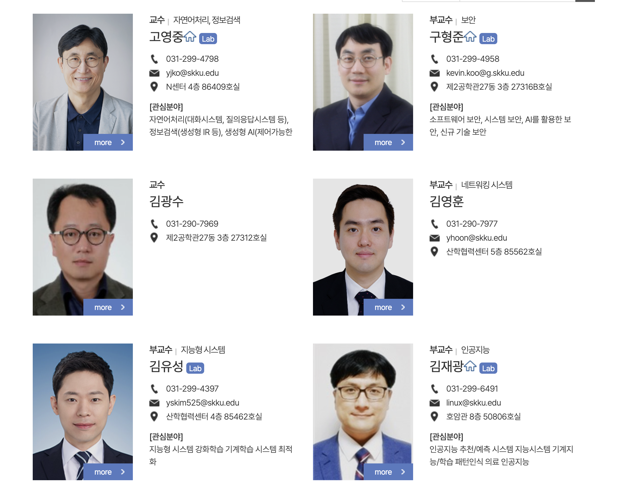
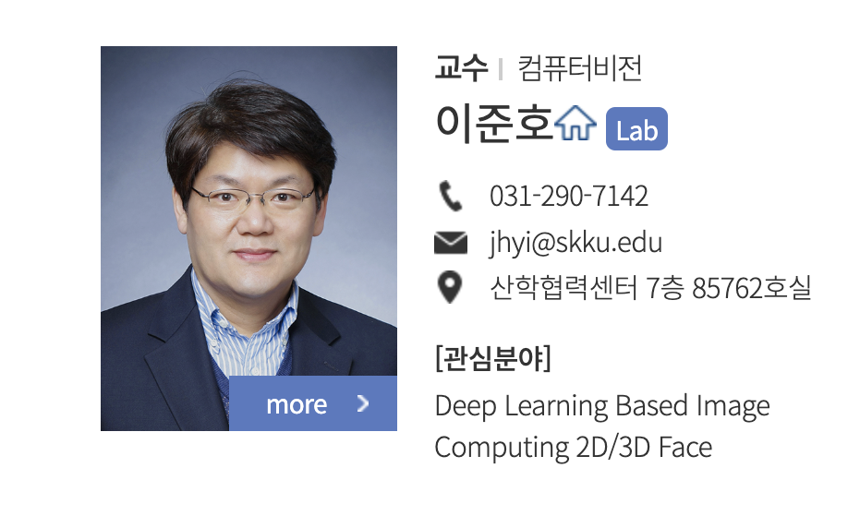

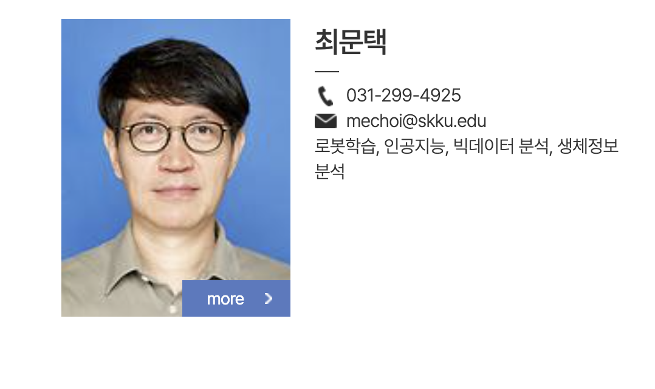
1. Motivation
No detailed areas
of interest of all professors.
Specific technology is not only used
in a single department laboratory.
2024-Fall Capstone Design Project
Team J (Last Lap) 김현진 송민석 장민석 조재희
Notes:
To participate in these programs, you need to communicate with a professor. In most cases, you would search for professors in your department's website who match your area of interest. However, sometimes the website may not provide detailed information about their specific research areas.
Additionally, for high-demand topics like artificial intelligence, professors in other departments may also conduct research in that field. In other words, it’s not easy to get a overview of research labs in our university.

Slide 6


2. Related Work
In korea
Abroad
PhD.KIM NET
RATE MY PROFESSORS
2024-Fall Capstone Design Project
Team J (Last Lap) 김현진 송민석 장민석 조재희
Notes:
There have been attempts to solve this problem for some time. In Korea, we have a service called 'KimPakSaNet', and overseas, there’s 'RateMyProfessor'.

Slide 7
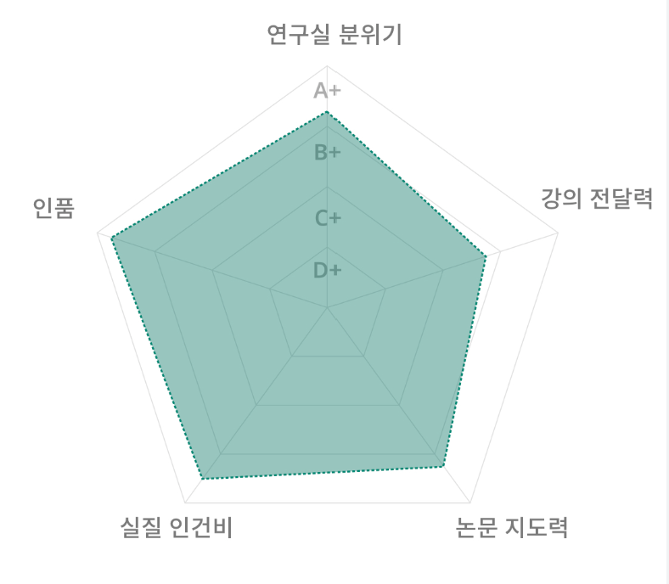
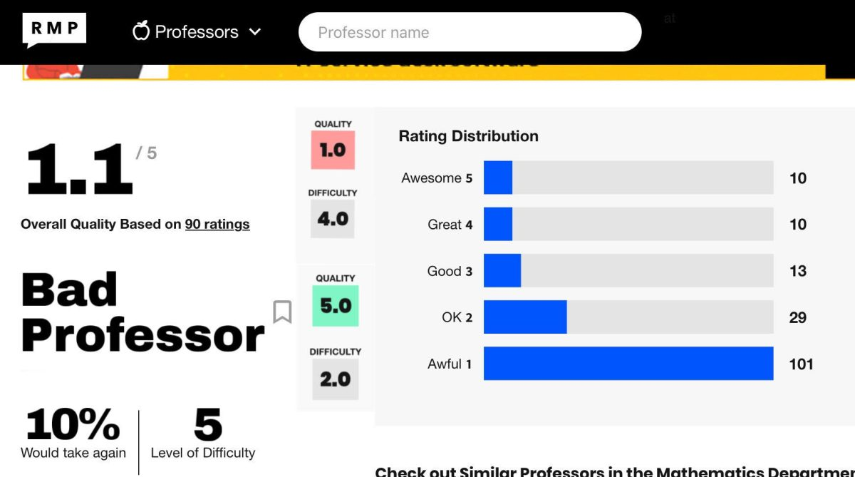
2. Related Work
In korea
Abroad
Lab Atmosphere
Character
Lecturing Ability
Sharing sensitive areas such as character and labor costs rather than professors' research areas
Evaluation of undergraduate classes is key content
Actual Wages
Thesis supervision
PhD.KIM NET
RATE MY PROFESSORS
2024-Fall Capstone Design Project
Team J (Last Lap) 김현진 송민석 장민석 조재희
Notes:
This is their main evaluation table.
However, KimPakSaNet focuses on sensitive topics like personality or real wages rather than research fields.
In case of RateMyProfessor, the key content is mostly based on undergraduate course evaluations.
One interesting thing is that both services have recently filed defamation lawsuits. At the last idea-sharing meeting, someone offered suggestions on students' evaluation, but this is also the main reason we didn't choose it because it was an existing service and there might be legal issues.

Slide 8



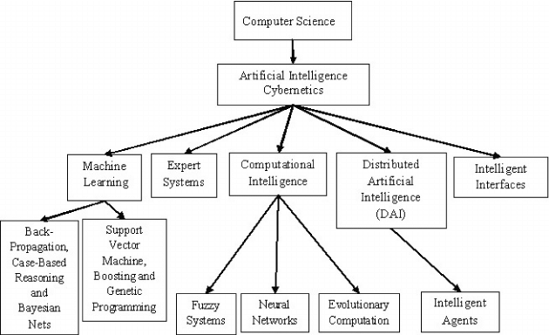
3. Problem Statement
1
2
Develop a program that analyzes the professor’s published papers to effectively identify the research areas of professor!
Difficulty in understanding professors’ research areas
Limited access to professors
outside of one’s department
3
Need for specific research area information beyond general topics
2024-Fall Capstone Design Project
Team J (Last Lap) 김현진 송민석 장민석 조재희
Notes:
In summary, it's difficult to get detailed information about a lab’s specific research areas, and finding labs across different departments requires a lot of effort. Moreover, searching for niche fields within larger areas is even more challenging. Therefore, we aim to create a program that provides lab information by analyzing research papers.

Slide 9






4. Proposed Solution
AI
Natural Language Lab
Machine Learning Lab
PhD Kim
#NLP #AI #ComputerVision
Recent Paper: How to get information from …
PhD Song
#ML #Unity #SmartFactory
Recent Paper: How to use machine Learning …
AI
Computer Graphics Lab
Security Lab
PhD Jo
#ML #Visualization #ComputerVision
Recent Paper: How to improve graphics by using AI …
PhD Lee
#Security #AI #SoftwareEngineering
Recent Paper: How to detect virus by AI…
2024-Fall Capstone Design Project
Team J (Last Lap) 김현진 송민석 장민석 조재희
Notes:
I'll show you a rough service use scenario.
First, when you input a field of interest on the page, a list of relevant labs will appear. In the case of areas of interest that users enter, it is possible in a large range such as AI, and we will support the search in more subdivided areas such as computer vision and object detection. The more subdivided you search, the higher the probability of finding a lab room that suits user. On the lab card, you will see key keywords and the titles of recent papers.

Slide 10
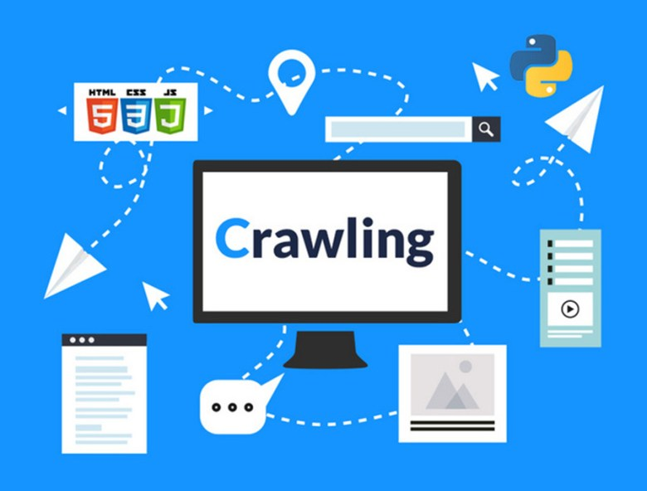

4. Proposed Solution
AI
Natural Language Lab
Machine Learning Lab
PhD Kim
#NLP #AI #ComputerVision
Recent Paper: How to get information from …
PhD Song
#ML #Unity #SmartFactory
Recent Paper: How to use machine Learning …
Computer Graphics Lab
Security Lab
PhD Jo
#ML #Visualization #ComputerVision
Recent Paper: How to improve graphics by using AI …
PhD Lee
#Security #AI #SoftwareEngineering
Recent Paper: How to detect virus by AI…
2024-Fall Capstone Design Project
Team J (Last Lap) 김현진 송민석 장민석 조재희
Notes:
We plan to use crawled data for this information.

Slide 11


Detailed introduction and guidance on the field the professor is researching
4. Proposed Solution
Detailed introduction and guidance on the field the professor is researching
AI
Machine Learning Lab (PhD Song)
A potential research direction could involve applying machine learning in smart factories to optimize processes such as automation, quality control, predictive maintenance, and defect detection. By integrating machine learning algorithms, factories can enhance efficiency, reduce errors, and improve overall productivity. This approach aligns with the growing demand for intelligent manufacturing systems and could lead to significant advancements in the field.
Recent Paper: How to use machine Learning in Factory
To Adjust Autogluon in Unity For Smart Factory
Laboratory that conducts similar research
Introduction to the laboratory conducting similar research with the professor
Natural Language Lab
Computer Graphics Lab
PhD Kim
#NLP #AI #ComputerVision
Recent Paper: How to get information from …
PhD Jo
#ML #Visualization #ComputerVision
Recent Paper: How to improve graphics by using AI …
2024-Fall Capstone Design Project
Team J (Last Lap) 김현진 송민석 장민석 조재희
Notes:
When you click on a specific lab card, more detailed information will appear. First, based on recent papers, there will be a description of the main research areas of the lab. I think you can know intuitive and accurate laboratory information by showing it in a little more detail.
As you scroll further, you'll see other labs conducting research on related topics, allowing for easy comparison. I'm going to allow you to click on these and go straight to the information in the lab.
These are the core features of the service, and we plan to add additional features as we continue development.

Slide 12
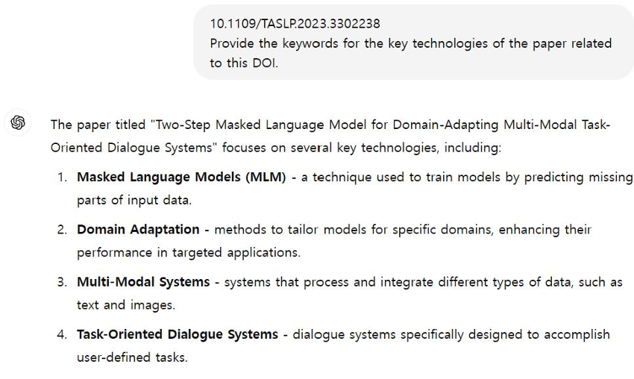

5. Technical Background
Prompt Engineering
Prompt engineering is the process of guiding generative AI solutions to produce the desired output.
In prompt engineering, the most appropriate format, syntax, words, and symbols are selected to guide the AI to interact with users more meaningfully.
2024-Fall Capstone Design Project
Team J (Last Lap) 김현진 송민석 장민석 조재희
Notes:
In this project, we plan to use prompt engineering and the SBERT model. First, prompt engineering refers to the process of guiding generative AI to produce the desired response. In prompt engineering, it is important to carefully select the format and contextual words. Various generative AI platforms explain techniques for effective prompt engineering. In our case, we plan to break down complex tasks into sub-tasks to achieve the desired outcomes.

Slide 13
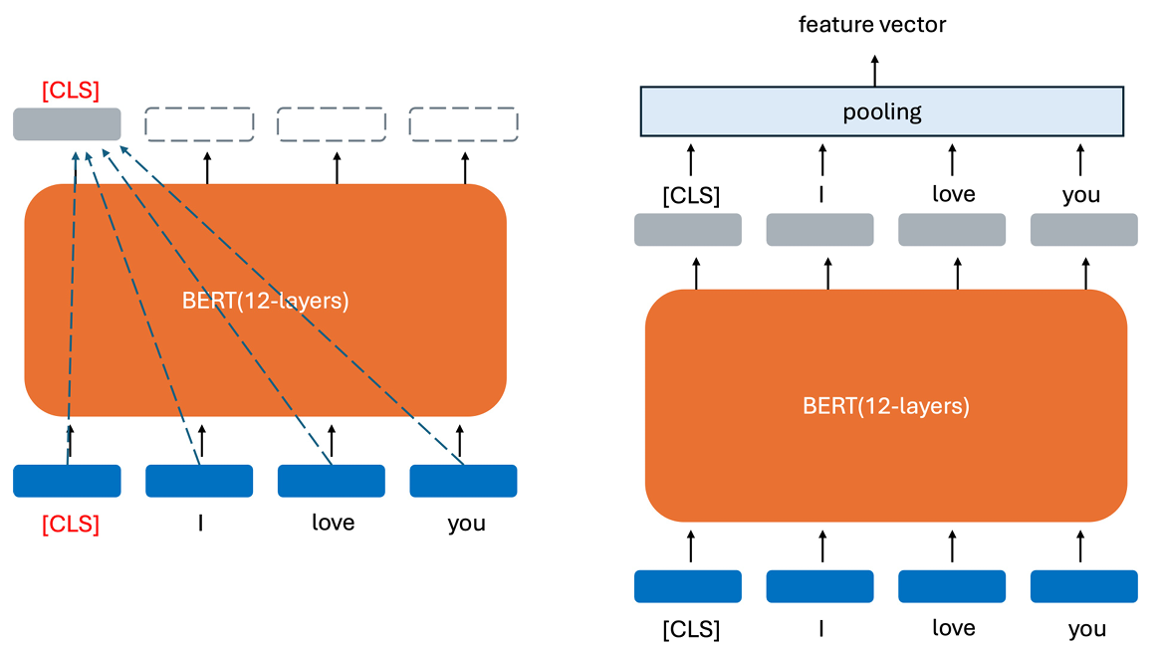
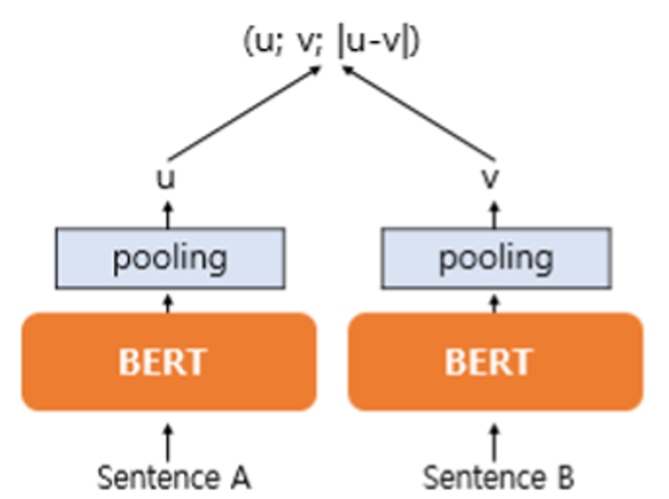
BERT is a bidirectional model that uses multiple layers of the transformer encoder, allowing attention to be applied to both past and future tokens. This bidirectional attention enables the [CLS] token to learn an embedding that captures the meaning of the entire sentence.
5. Technical Background
BERT
BERT is a bidirectional model that uses multiple layers of the transformer encoder, allowing attention to be applied to both past and future tokens.
SBERT
SBERT enhances BERT by adding a pooling layer to use embeddings and processes each sentence separately, unlike BERT, which uses a single Transformer for both.
2024-Fall Capstone Design Project
Team J (Last Lap) 김현진 송민석 장민석 조재희
Notes:
Next, we have the BERT models. The image shown depicts the structure of the original BERT model. BERT is a bidirectional model that stacks multiple layers of the original transformer’s encoder structure. In the original transformer, the attention process, which mixes the information between tokens, was only applied to previous tokens relative to the current token. However, in BERT, this attention is applied bidirectionally, including future tokens, allowing the [CLS] token to learn a feature embedding that contains the meaning of all tokens in the sentence.
The structure of the model we intend to use in our program, SBERT, is as right figure. The structure of SBERT adds a pooling layer to the output of the original BERT model to utilize the extracted embeddings. Unlike BERT, SBERT passes two sentences through a single transformer and processes each sentence separately through the Transformer.
SBERT is also efficient in terms of training time because it only requires f ine-tuning on a pretrained BERT model.

Slide 14
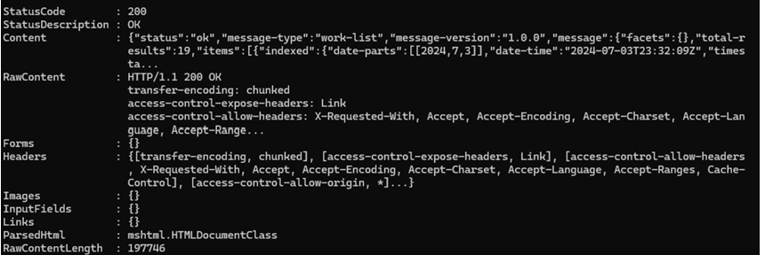
5. Technical Background
The Message returned by Crossref allows us to obtain the DOI through the work-list in the content section
Core keywords of technologies are extracted through DOI using GPT prompting
2024-Fall Capstone Design Project
Team J (Last Lap) 김현진 송민석 장민석 조재희
Notes:
Then, I will explain what happens at the back end while using the service.
We will first obtain the professor’s ORCID to secure the DOI of their papers via the Crossref API, which provides access to various metadata, including DOIs for research publications. Left figure shows message return by Crossref allows us to obtain the DOI through the work-list in the content section
And then, we will extract key technologies from the abstract of each paper. These technologies will be stored in a database and registered as research topics for the professor. We will also count how many papers have been published on each topic to calculate the frequency of research topics.

Slide 15
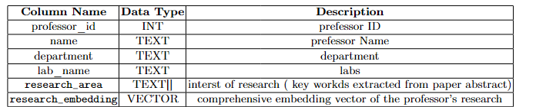
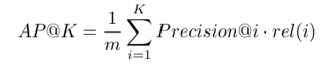
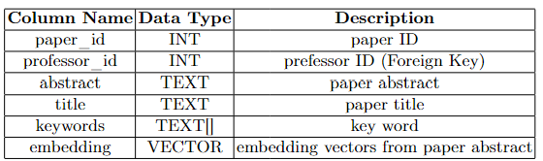
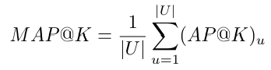
5. Technical Background
Shape of the dataset after preprocessing
Mean Average Precision @ K (mAP) as the evaluation metric, which takes the order of recommendations into account.
2024-Fall Capstone Design Project
Team J (Last Lap) 김현진 송민석 장민석 조재희
Notes:
As a core technology of this project, we will fine-tune a SBERT model to build a search system that integrates technical synonyms and related terms. This will allow us to accurately determine how frequently the professor researches specific technologies.
Since the goal is to search for professors and labs, the embedding vec tors of the extracted abstracts are used to calculate a comprehensive embedding vector for each professor’s research, which is then stored in the professor table and the paper table. A similarity calculation is performed based on the embed dings of the search query and the professors’ embeddings, and the professor most relevant to the search query is presented to the user
For evaluation metrics such as Precision@K or Recall@K, the number of items of interest to the user among the top K recommended items is estimated. However, since the order of recommendations is likely to be important in our model, we will use Mean Average Precision @ K (mAP) as the evaluation metric, which takes the order of recommendations into account

Slide 16








6. Role & Project Plan
Frontend
Data Collection
Backend,
Data Preprocessing
AI Model Design, Data Preprocessing
김현진
장민석
송민석
조재희
2024-Fall Capstone Design Project
Team J (Last Lap) 김현진 송민석 장민석 조재희
Notes:
The project is largely divided into two categories: AI and web development. Web includes front-end and back-end. AI includes data collection, data preprocessing and model implementation. We decided our main roles based on the interest and competence of each team member. Although each has their own part, it will be f lexible if needed during the project.

Slide 17
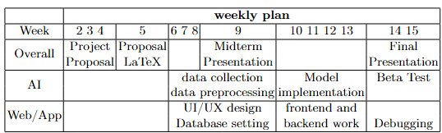
6. Role & Project Plan
2024-Fall Capstone Design Project
Team J (Last Lap) 김현진 송민석 장민석 조재희
Notes:
Based on the roles that were largely divided into two categories, we planned the project schedule by dividing it into front-end, back-end, and AI parts. Although it is the schedule planned, it is aware some might change during the project depending on situation and progress.

Slide 18
Q & A
2024-Fall Capstone Design Project
Team J (Last Lap) 김현진 송민석 장민석 조재희
Notes:
Dependence on ORCID This project is based on ORCID, a widely used researcher and contributor identifier. While many professors use ORCID, the program may not function properly for those who do not use or update their ORCID profiles. The Google Scholar API can be used to partially supplement this, but since it operates through crawling, it may result in a time disadvantage.
Challenges with GPT-4 Prompting Feedback AlthoughGPT-4prompting demonstrates powerful capabilities, the difficulty in receiving user feedback can lead to decreased reliability of results. To address this, we will implement an algorithm to review and potentially reject keywords that significantly deviate from existing keywords or the professor’s broader research areas when storing data in the database. Additionally, we will refine the data through user feedback and ensure that the prompt design avoids generating false information for DOIs that cannot be extracted.

